Slide 1
Transport Management System
Abdullah al ishtiaq – 1505080
Shashata Sawmya - 1505089

Slide 2
ENTITIES OF THE PREPARED SCENARIO
1. Division
2. Vehicle
3. Owner
4. Driver
5. License
6. Employee
7. Penalty
8. Service
9. Payment
10. Public Transport

Slide 3
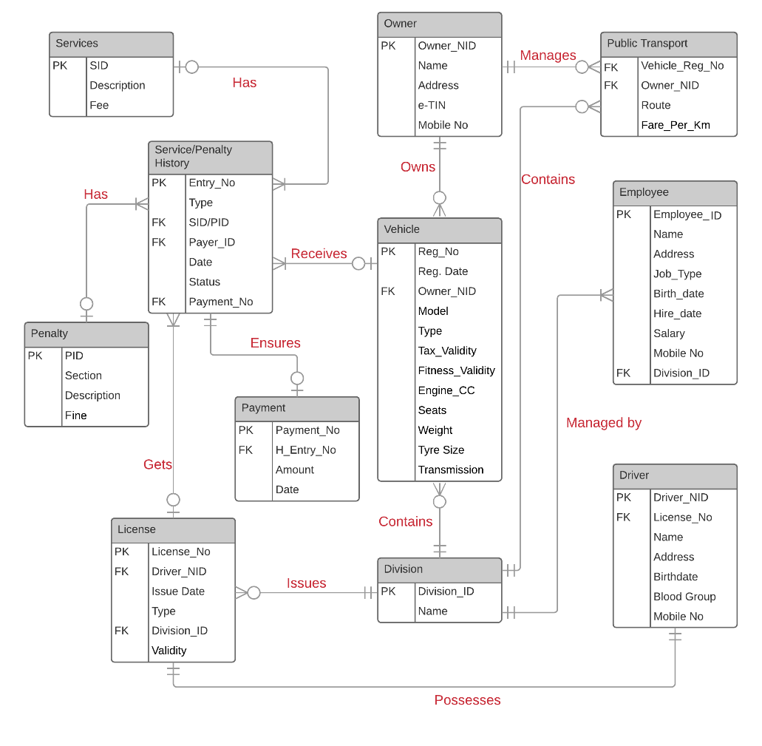

Slide 4
Relationship Schema
Division (Division_id, name)
Vehicle (Reg_no., Reg_date, Owner_NID, Model, Type, Fitness validity, Tax Validity, Engine CC, Seats, Weight, Tire Size, Transmission)
Owner (Owner_NID, Name, Address, E-TIN, Mobile number)
Employee Table (Employee_ID, NAME, ADDRESS, Job type, Birthday, Hire_date, Salary, Mobile number, Division_Id)
Driver Table (Driver_NID, License_No, Name, Address, Birthday, Blood Group, Mobile Number)
License Information Table (License_No, Issue date, Type, Validity, Division_Id)
Service Table (Service_Id, Description, Fee)
Penalty Table (Penalty_Id, Section, Description, Fine)

Slide 5
Relationship Schema (Cont.)
Service/Penalty Collection (Entry_no., Type, SID/PID, Payer_NID, date, status, Payment_no.)
Service Charge/ Penalty Fine Payment (Payment_no., H_Entry_no., Amount, Date)
Public Transport (Vehicle_Reg_no., Owner_NID, Name, Route, Fare per K.m.)

Slide 6
Sample Queries
1. What is the total number of cars in a division named ‘Dhaka’?
2. Which buses are there from Azimpur to Mirpur?
3. List all employees who earns under 50,000/= and whose Job Type is ‘Maintenance’.
4. List all vehicles whose fitness validity has expired
5. What is the fine for breaking a Road Law Section – 63?
6. List the name of services and their fees.
7. How many times a driver having a license number ‘89265’ has been fined?

